Slide 1
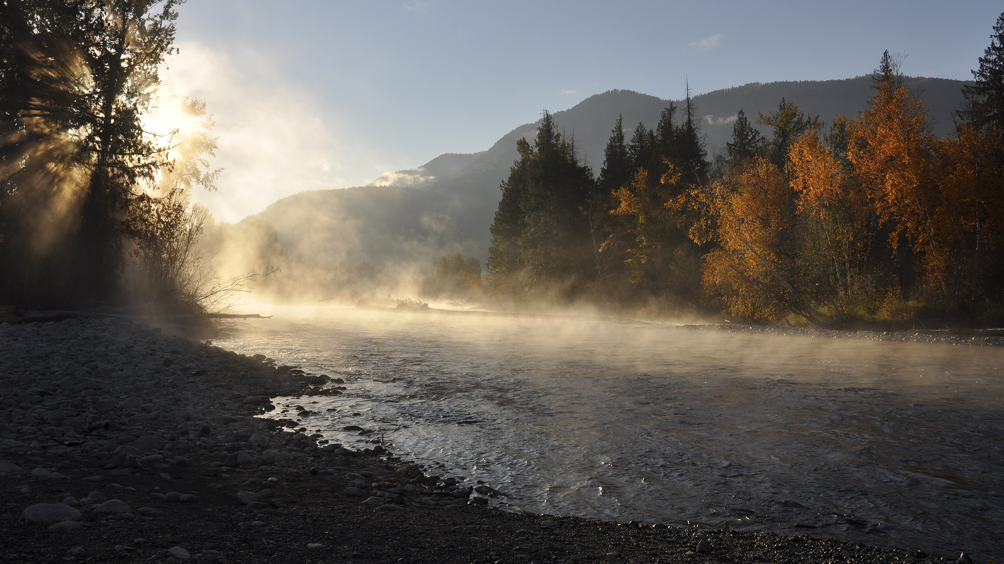
Preliminary 2025 Pacific Salmon Outlook

Slide 2
PRESENTATION OUTLINE
Introduction
Area Outlooks
Discussion
Conclusion
Fraser and Interior
North Coast
South Coast
Yukon Transboundary
Chinook
Chum
Coho
Sockeye
Pink
Chinook
Chum
Coho
Sockeye
Pink
Chinook
Chum
Coho
Sockeye
Pink
Chinook
Chum
Coho
Sockeye
Pink
Notes:
Category names may change e.g., Discussion/Conclusion
Adjust Sockeye Lake Type vs River Type
Specify Pink Even (vs odd)

Slide 3
INTRODUCTION
Purpose of the Outlook
Provide expected salmon abundance for 2026
Inform harvest planning and management decisions
Combine expert opinion and statistical forecast, where available

Slide 4
INTRODUCTION
Contributors
Stock assessment biologists across the Region
Collaborative programs with First Nations
Other stakeholders and stewardship groups

Slide 5
INTRODUCTION
How Outlooks Are Defined
By default, SMU scale
Apply the Precautionary Approach
If CU-level data available:
Use CU scale, apply Wild Salmon Policy benchmarks
For data-limited stocks:
Use SMU scale, rely on expert judgment

Slide 6
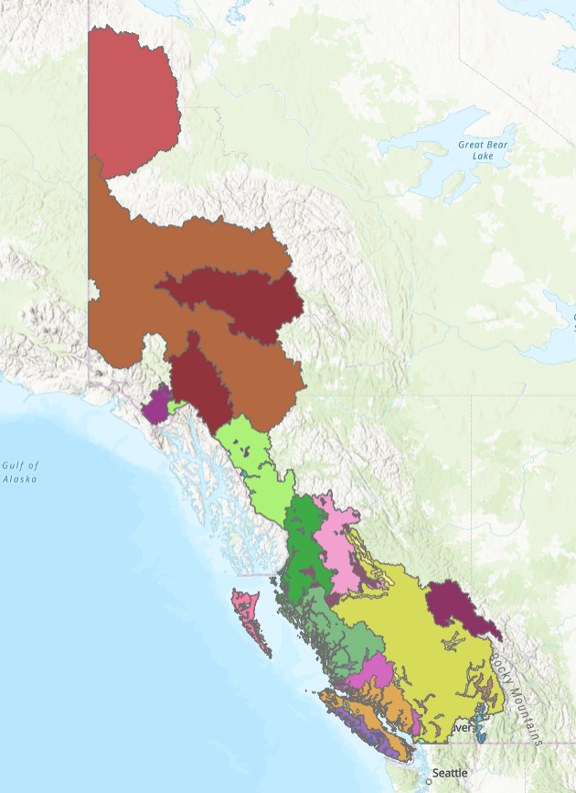
INTRODUCTION
Stock Management Units
What is an SMU?
A group of one or more Conservation Units (CUs) managed together
Harvest rules usually apply to the aggregate
Why use SMUs?
Practical grouping of CUs for harvest planning and reporting
Basis for Integrated Fisheries Management Plans (IFMPs)
Important Notes
CU-level diversity still considered
Precautionary Approach often applied within SMUs
SMUs for [sp.] salmon
Notes:
Need to update map. Maybe colour by Area. Change projection.

Slide 7
INTRODUCTION
Biological and Management References
Purpose of forecasts and outlooks
Inform harvest managers about expected stock abundance
Support adjustments to harvest plans
References points and targets
Biological benchmarks or limit reference points included when available
Management targets noted if in place
Current gap
Many stocks lack defined references
Work is ongoing to develop methods and analyses

Slide 8
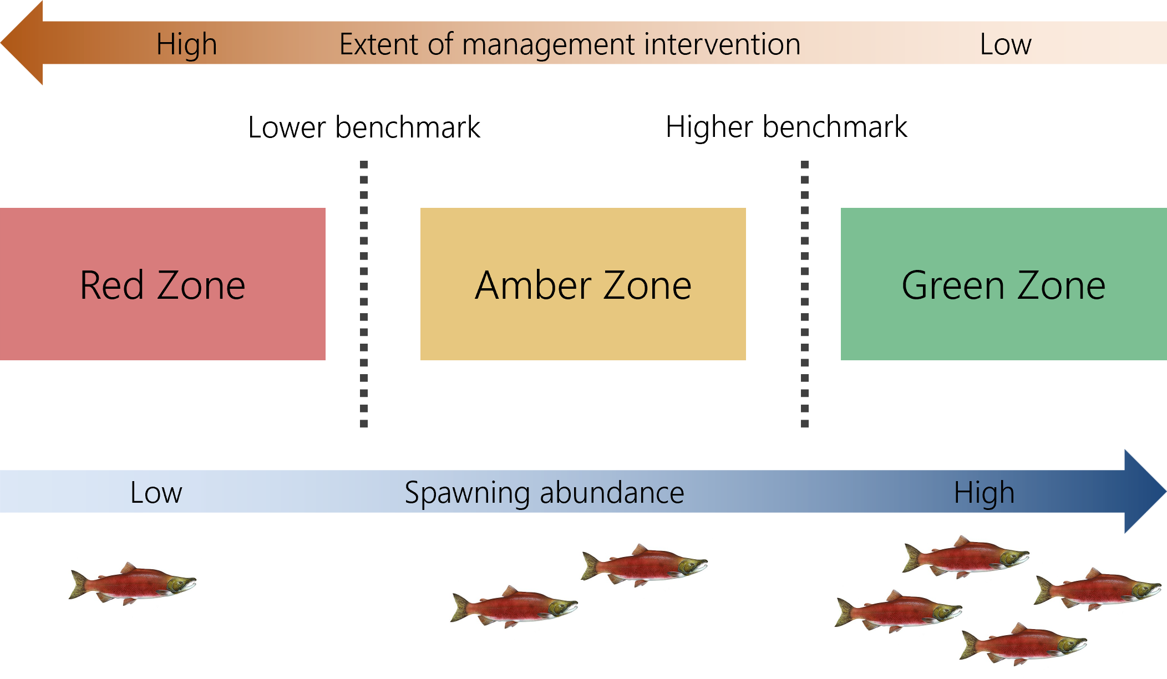
INTRODUCTION
Wild Salmon Policy Benchmarks
CU-level assessment under WSP
CUs are assessed against biological benchmarks
Benchmarks indicate significant changes in production status
Zones and management response
Red: Low abundance ➔ high intervention
Amber: Moderate abundance ➔ caution
Green: High abundance ➔ low intervention
Benchmarks and zones under the Wild Salmon Policy (DFO, 2005)

Slide 9
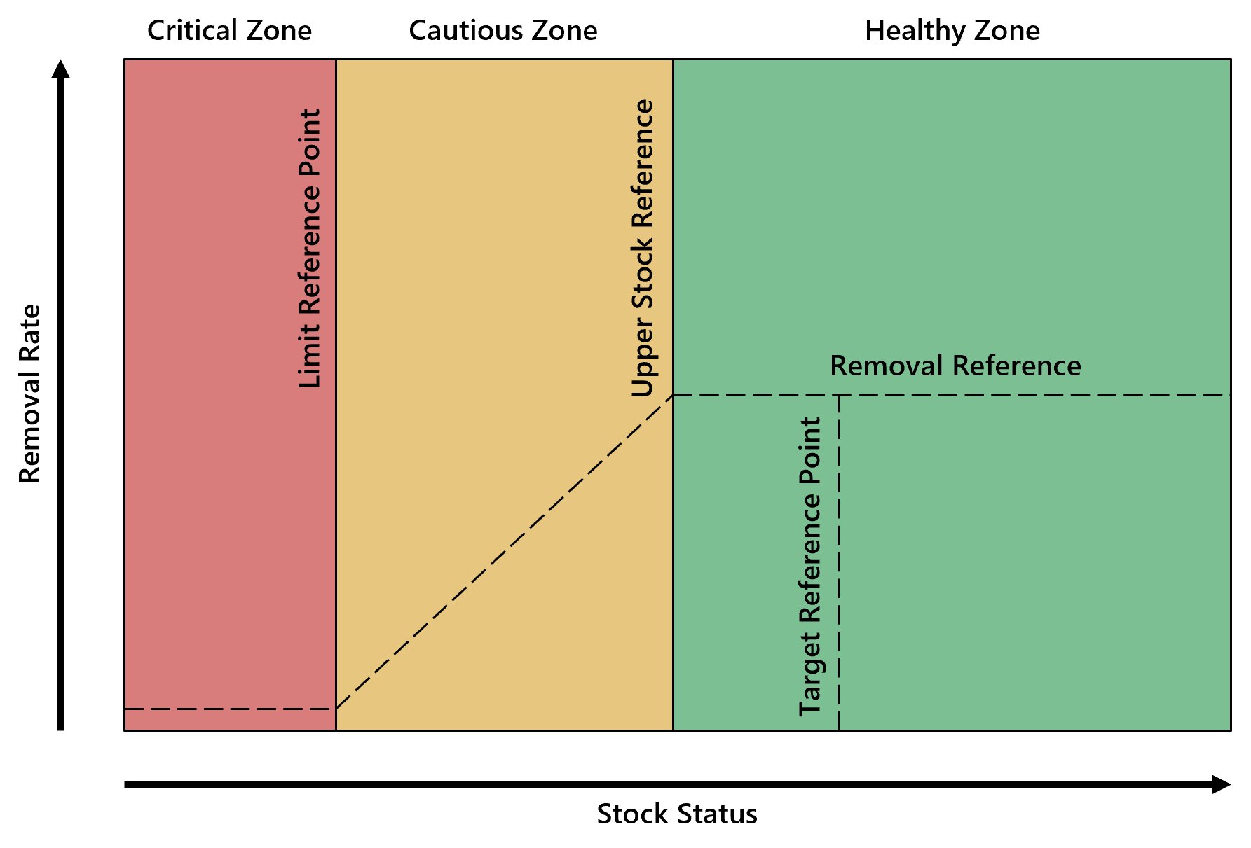
INTRODUCTION
Precautionary Approach
For SMUs: harvest decisions use reference points
Limit Reference Point (LRP) = critical harvest threshold
Below LRP ➔ major stock and ecosystem risk
Methods for defining LRPs vary by data availability
DFO’s precautionary principal
Notes:
Should color be removed? Keep that specific to WSP? Adjust to be more than just LRP

Slide 10
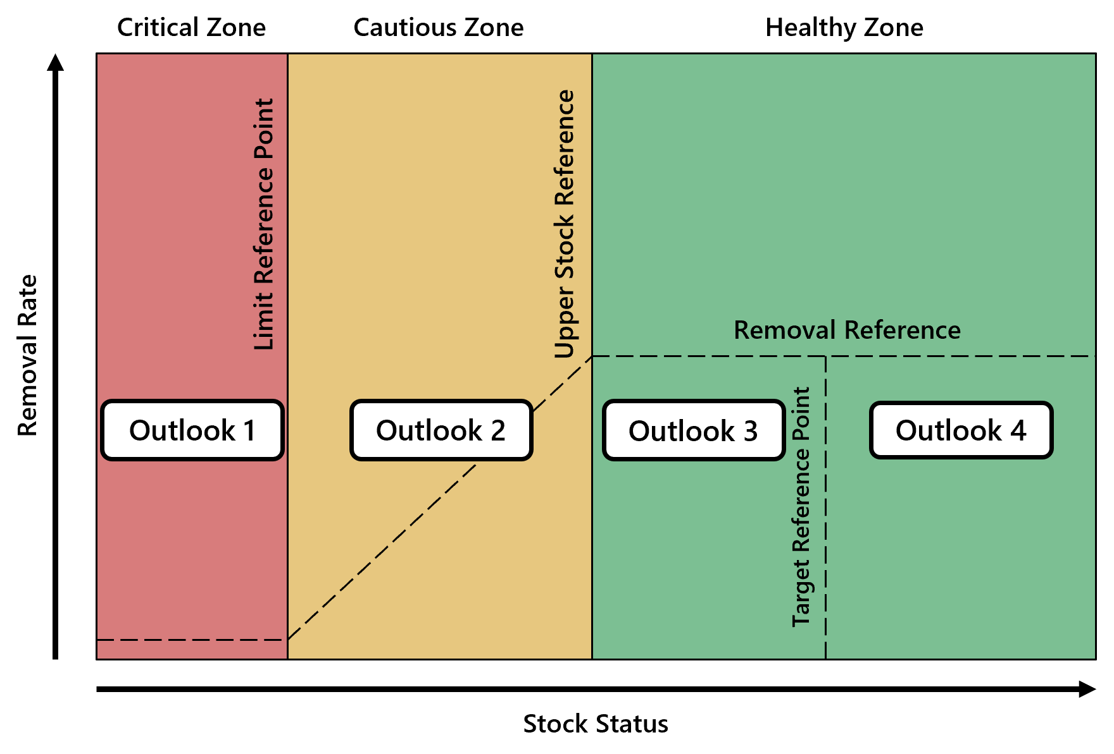
INTRODUCTION
Outlook Categories: Combining Approaches
Outlook Category | CUs or SMUs with references |  |  | Data-Limited CUs or SMUs
 | Wild Salmon Policy (CU Level) | Precautionary Approach (SMU Level) |  | Category Definition | Expected spawning abundance (percentile)
1 | Red Zone | Critical Zone |  | Well below average | <25
2 | Amber Zone | Cautious Zone |  | Below average | 25–40
3 | Green Zone | Healthy Zone |  | Near average | 40–60
4 | Green Zone | Healthy Zone |  | Abundant | >60
Data Deficient | - | - |  | Insufficient information | Unknown
Notes:
Need to show “1 to 2”, “2 to 3” etc?
Need labels for the WSP benchmarks??

Slide 11
CONCLUSION
Access Previous & Upcoming Outlooks
2024 Final Outlook
Pacific Salmon Outlook, Pacific Region 2024 (PDF)
2025 Final Outlook
Pacific Salmon Outlook, Pacific Region 2024 (PDF)
The final 2026 Outlook will be posted on the DFO Library once forecasts are completed
Notes:
How far back do these go???

Slide 12
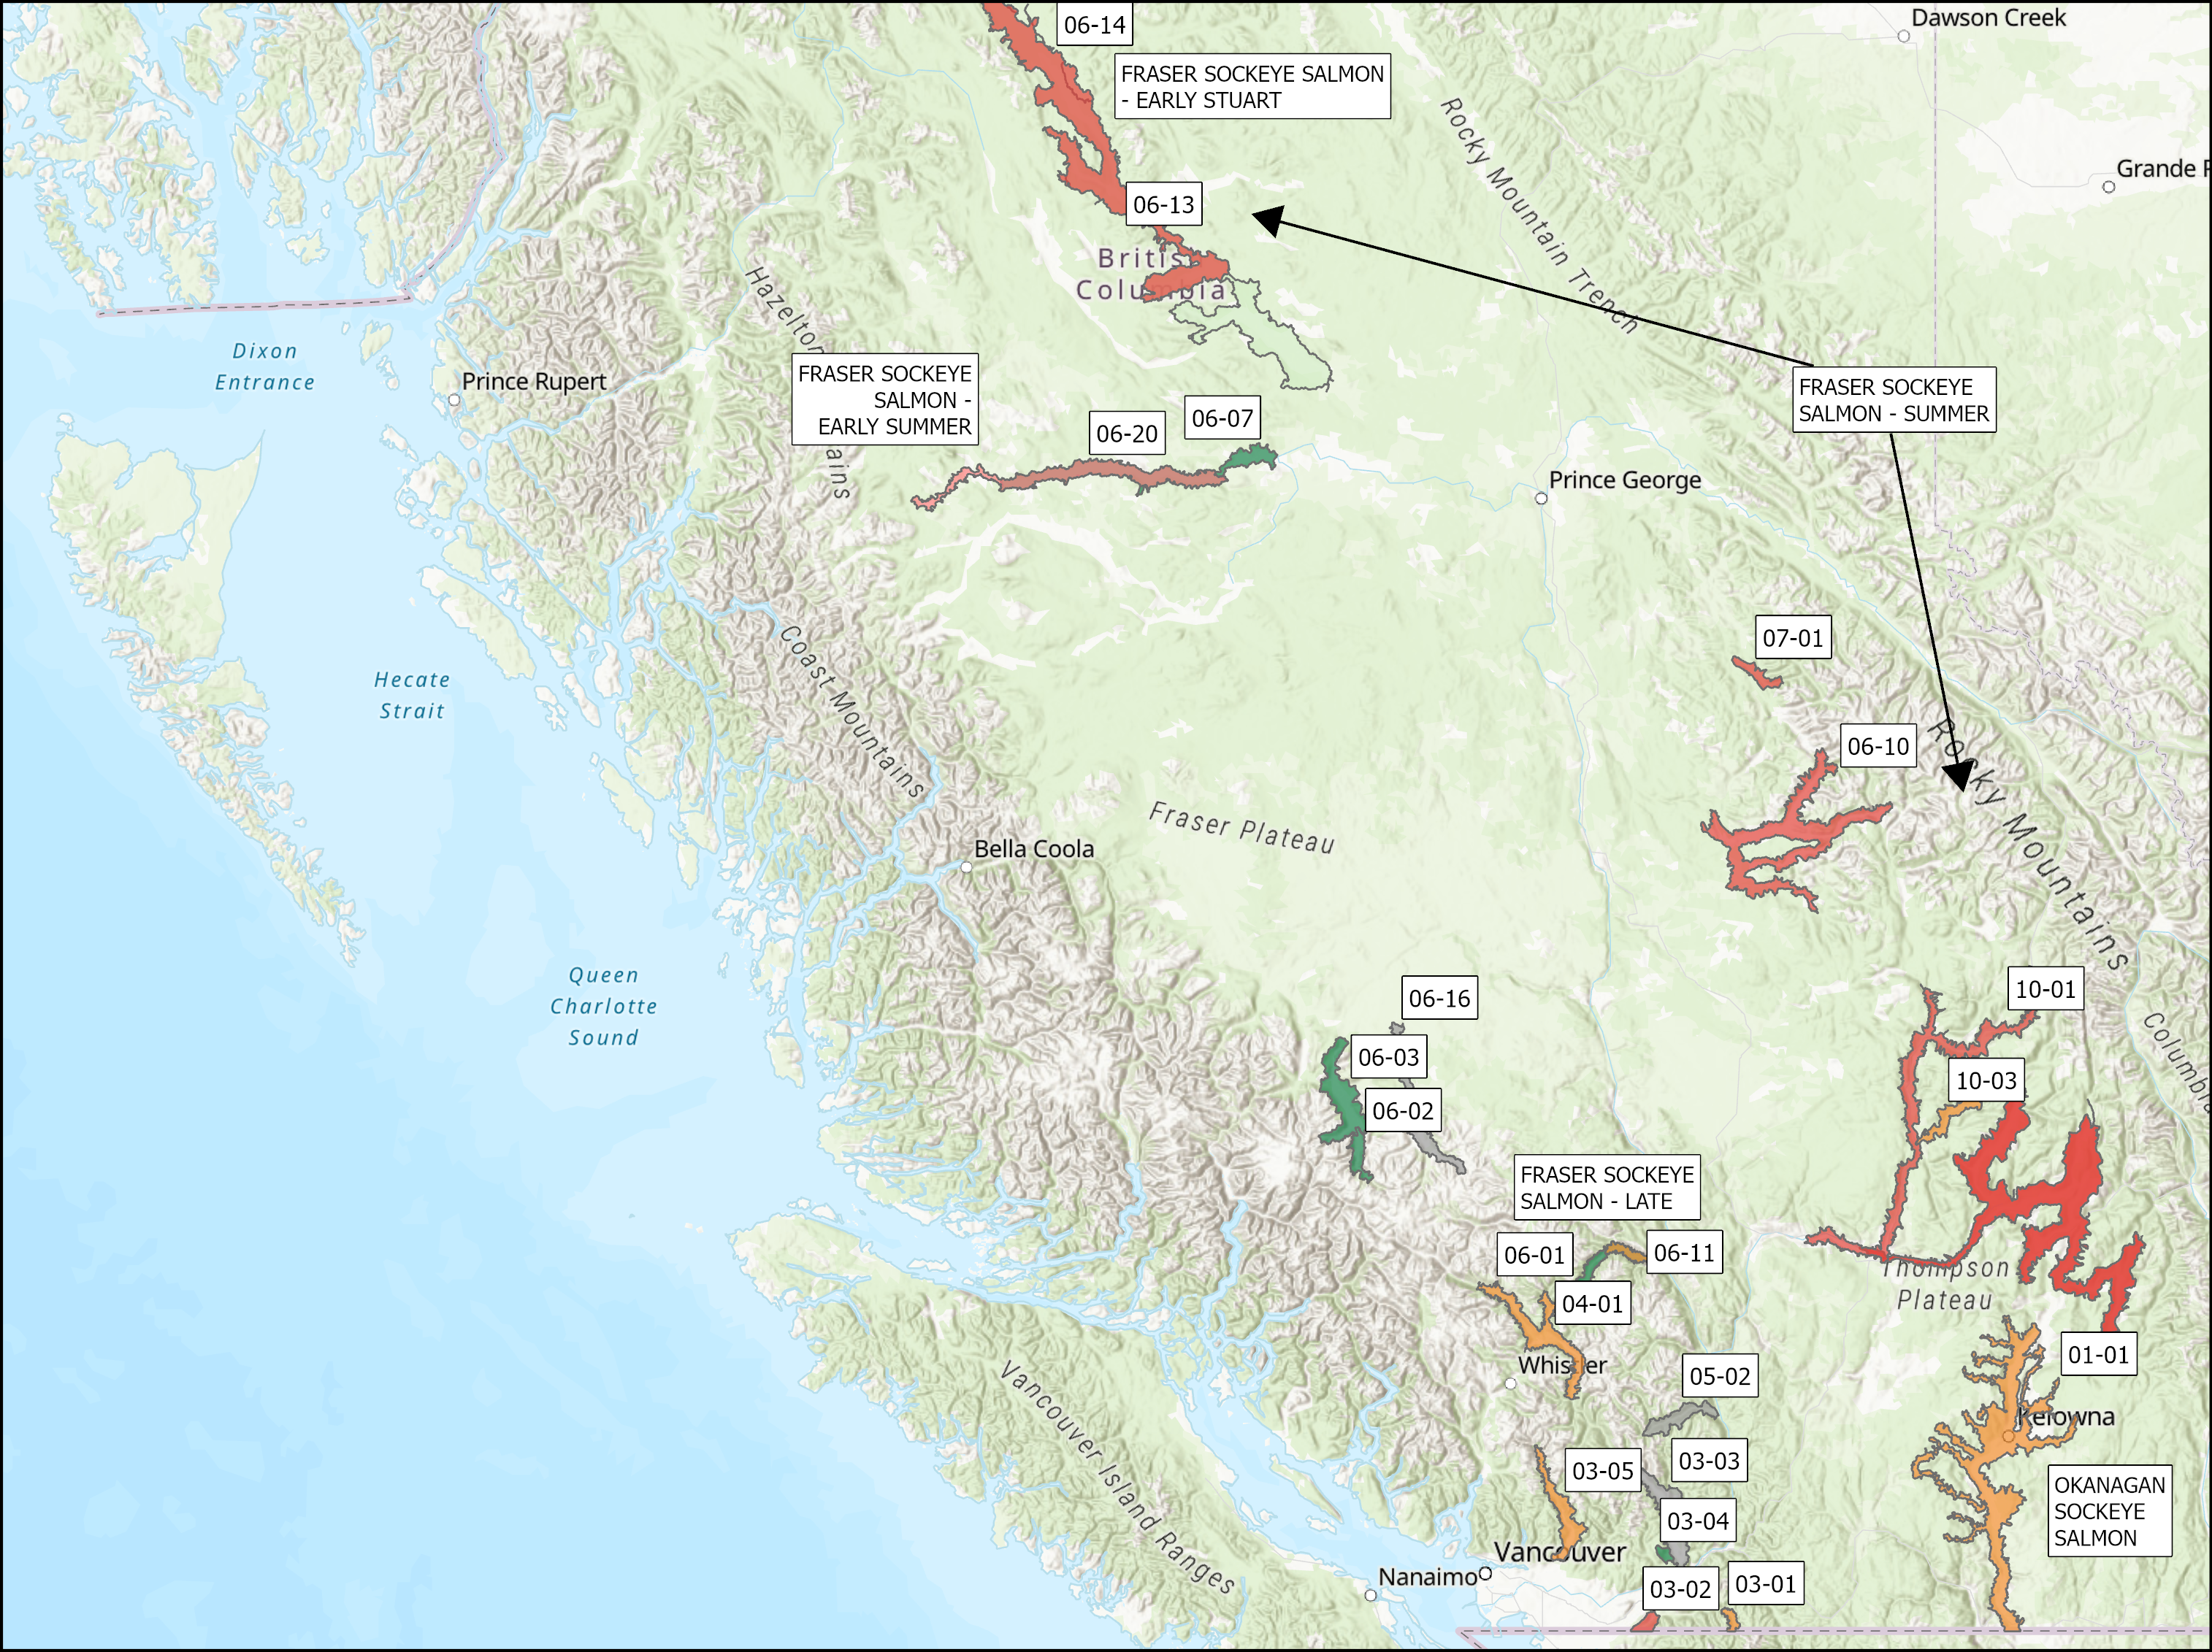
FRASER AND INTERIOR – SOCKEYE
SMU | CU / Subunit | Outlook
Fraser Sockeye Salmon -Early Stuart | Takla/ Trembleur-Early Stuart Timing | 1
Lower Fraser | CHILLIWACK-EARLY SUMMER TIMING | 1-4
Lower Fraser | PITT-EARLY SUMMER TIMING | 1-3
Lower Fraser | NAHATLATCH-EARLY SUMMER TIMING | NA
South Thompson | SHUSWAP-EARLY SUMMER TIMING (Seymour and Scotch) | 1
North Thompson | NORTH BARRIERE-EARLY SUMMER TIMING | 2
Mid and Upper Fraser | ANDERSON/SETON-EARLY SUMMER TIMING | 4
Mid and Upper Fraser | NADINA/FRANCOIS-EARLY SUMMER TIMING | 1-2
Mid and Upper Fraser | BOWRON-EARLY SUMMER TIMING | 1
Mid and Upper Fraser | TASEKO-EARLY SUMMER TIMING | NA
Fraser Sockeye Salmon - Summer | HARRISON RIVER | 1-2
Fraser Sockeye Salmon - Summer | QUESNEL-SUMMER TIMING | 1
Fraser Sockeye Salmon - Summer | RAFT RIVER/ KAMLOOPS-EARLY SUMMER TIMING | 1
Fraser Sockeye Salmon - Summer | STELLAKO /FRANCOIS/FRASER-SUMMER TIMING | 4
Fraser Sockeye Salmon - Summer | CHILKO-SUMMER TIMING and CHILKO ES | 4
Fraser Sockeye Salmon - Summer | LATE STUART/ TAKLA/TREMBLEUR/STUART-SUMMER TIMING | 3
Fraser Sockeye Salmon - Late | CULTUS-LATE TIMING | 1
Fraser Sockeye Salmon - Late | PORTAGE CREEK / SETON-LATE TIMING | 2
Fraser Sockeye Salmon - Late | SOUTH THOMPSON/ SHUSWAP COMPLEX-LATE TIMING | 1
Fraser Sockeye Salmon - Late | BIRKENHEAD / LILLOOET/HARRISON-LATE TIMING | 1-3
Fraser Sockeye Salmon - Late | WEAVER CREEK / HARRISON-UPSTREAM MIGRATING-LATE TIMING | 4
Fraser Sockeye Salmon - Late | BIG SILVER CREEK / HARRISON-DOWNSTREAM MIGRATING-LATE TIMING | NA
Fraser Sockeye Salmon - Late | WIDGEON CREEK | NA
Okanagan Sockeye | OSOYOOS | 2
Separate out Early Summer vs Summer etc.
Notes:
Expectations are for an average Somass Sockeye return in 2025, based on ocean indicators returns to date, and marine survival rates
Henderson: The 2024 adult return was low. The age composition data showed similar abundances of 42s and 52s. Expectations are for a below-average return.

Slide 13
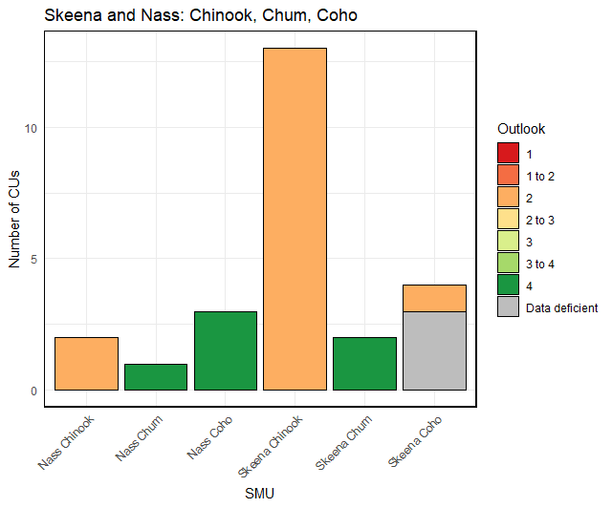
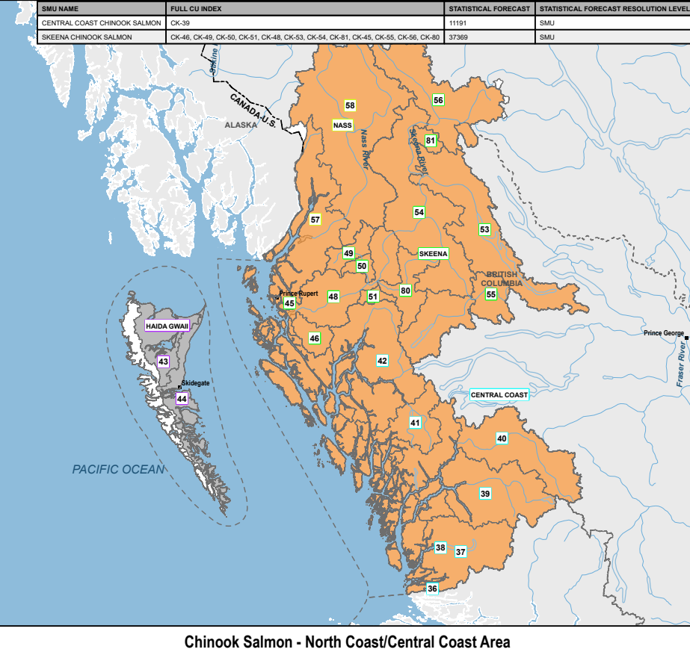
Skeena and Nass
Chinook, Chum, Coho
SMU | CU / Subunit | Outlook
Nass Chinook | Aggregate (2 CUs) | 2
Skeena Chinook | Aggregate (12 CUs) | 2
 | Kitsumkalum Indicator | 2
Nass Coho | Aggregate (3 CUs) | 4
Skeena Coho | Aggregate (3 CUs) | DD
 | Middle Skeena (1 CU) | 2
Nass Chum | Lower Nass (1 CU) | 4
Skeena Chum | Aggregate (2 CUs) | 4
Notes:
Expectations are for an average Somass Sockeye return in 2025, based on ocean indicators returns to date, and marine survival rates
Henderson: The 2024 adult return was low. The age composition data showed similar abundances of 42s and 52s. Expectations are for a below-average return.

Slide 14
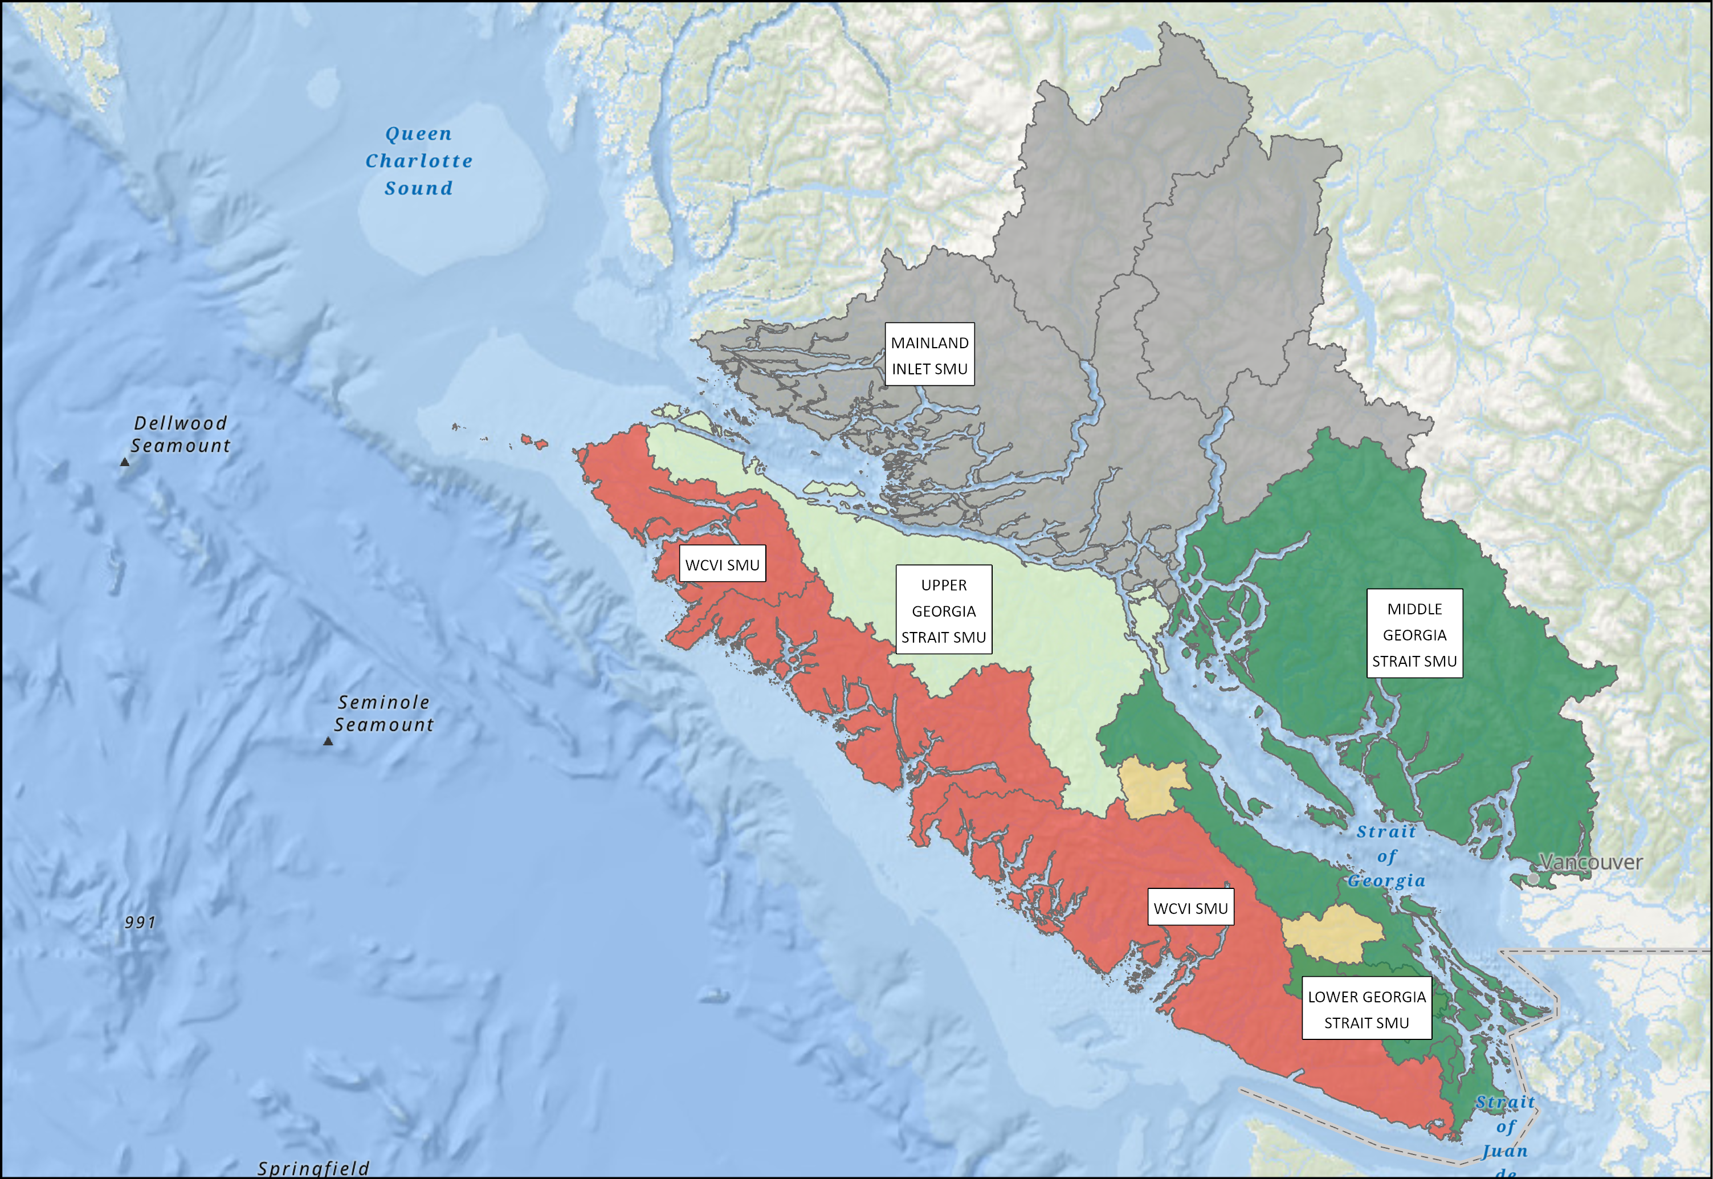
YUKON TRANSBOUNDARY - SOCKEYE
South Coast Area - Chinook
SMU | CU / Subunit | Outlook
Mainland Inlet | Aggregate (4 CUs) | DD
Upper Georgia Strait | Quinsam River Fall Run | 3
Middle Georgia Strait | Puntledge and Big Qualicum Rivers Fall Run Enhanced | 4
Middle Georgia Strait | Nanaimo and Puntledge Summer Enhanced | 1-2
Lower Georgia Strait | Cowichan River Fall Run Unenhanced | 4
West Coast Vancouver Island | Aggregate ( ?? CUs) | 2
Notes:
Expectations are for an average Somass Sockeye return in 2025, based on ocean indicators returns to date, and marine survival rates
Henderson: The 2024 adult return was low. The age composition data showed similar abundances of 42s and 52s. Expectations are for a below-average return.

Slide 15
2025 Preliminary Outlook Quick Reference
Yukon/Transboundary |  |  | North Coast/Central Coast |  |  |  |  | South Coast |  |  |  | Fraser River/BC Interior
Chinook |  |  | Chinook |  |  |  |  | Chinook |  |  |  | Chinook
ALSEK CHINOOK | 3 |  | CENTRAL COAST CHINOOK | 1 to 2 |  |  |  | LOWER GST CHINOOK | 4 |  |  | FRASER FALL RUN 41 CHINOOK | 3
PORCUPINE CHINOOK | 1 |  | HAIDA GWAII CHINOOK | DD |  |  |  | MAINLAND INLET CHINOOK | DD |  |  | FRASER SP RUN 42 CHINOOK | 1
STIKINE CHINOOK | 1 |  | NASS CHINOOK | 2 |  |  |  | MIDDLE GST CHINOOK | 2 to 3 | 4 |  | FRASER SP RUN 52 CHINOOK | 2
TAKU CHINOOK | 4 |  | SKEENA CHINOOK | 2 |  |  |  | UPPER GST CHINOOK | 3 |  |  | FRASER SU RUN 41 CHINOOK | 1 |  | 4
YUKON CHINOOK | 1 |  | Chum |  |  |  |  | WCVI CHINOOK | 1 | 4 |  | FRASER SU RUN 52 CHINOOK | 2
Chum |  |  | CENTRAL COAST CHUM | 1 | 2 | DD |  | Chum |  |  |  | OKANAGAN CHINOOK | 1
PORCUPINE CHUM | 1 to 2 |  | HAIDA GWAII CHUM | 1 to 2 |  |  |  | INNER SOUTH COAST CHUM | 2 to 3 |  |  | Chum
TRANSBOUNDARY CHUM | DD |  | SKEENA/NASS CHUM | 4 |  | DD |  | WCVI CHUM | 3 |  |  | FRASER CHUM | 2
YUKON CHUM | 1 to 2 |  | Coho |  |  |  |  | Coho |  |  |  | Coho
Coho |  |  | CENTRAL COAST COHO | 3 |  | DD |  | JST/MAINLAND INLET COHO | 2 |  |  | INTERIOR FRASER COHO | 2
ALSEK COHO | 3 |  | HAIDA GWAII COHO | DD |  |  |  | STRAIT OF GEORGIA COHO | 3 |  |  | LOWER FRASER COHO | Data Deficient
STIKINE COHO | DD |  | NASS COHO | 4 |  |  |  | WCVI COHO | 3 |  |  | Pink
TAKU COHO | 3 |  | SKEENA COHO | 2 |  | DD |  | Pink |  |  |  | FRASER PINK - ODD | 4
PORCUPINE COHO | DD |  | Pink |  |  |  |  | ECVI/MNLAND PINK- EVEN | N/A |  |  | Sockeye
Sockeye |  |  | CENTRAL COAST PINK | 2 | 3 | DD |  | ECVI/MNLAND PINK - ODD | 2 to 3 | 3 |  | FRASER SOCKEYE - ESTU | 1
ALSEK SOCKEYE | 3 |  | HAIDA GWAII PINK | DD |  |  |  | WCVI PINK | Data Deficient |  |  | FRASER SOCKEYE - ESUM | 1 | 2 | 4
STIKINE SOCKEYE | 2 to 3 |  | NASS PINK | 4 |  |  |  | Sockeye |  |  |  | FRASER SOCKEYE - LATE | 1 | 2 | 4
TAKU SOCKEYE | 4 |  | SKEENA PINK | 4 |  |  |  | ECVI/MAINLAND SOCKEYE | 1 | 2 |  | FRASER SOCKEYE - SUMMER | 1 | 3 | 4
 |  |  | Sockeye |  |  |  |  | WCVI - BARKLEY SOCKEYE | 2 | 3 |  | OKANAGAN SOCKEYE | 2
 |  |  | CENTRAL COAST SOCKEYE | DD |  |  |  | WCVI - OTHER SOCKEYE | Data Deficient
 |  |  | HAIDA GWAII SOCKEYE | 3 | DD
 |  |  | NASS SOCKEYE | 4
 |  |  | RIVERS/SMITH SOCKEYE | 1
 |  |  | SKEENA SOCKEYE | 4
4 bar charts by Area

Slide 16
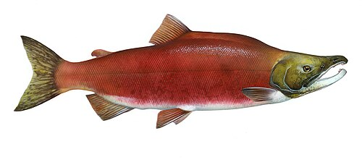
INTRODUCTION
FOR EDITING
High Extent of management intervention Low
Lower benchmark
Higher benchmark
Red Zone
Amber Zone
Green Zone
Low Spawning abundance High

Slide 17
INTRODUCTION
FOR EDITING
Critical Zone
Cautious Zone
Healthy Zone
Limit Reference Point
Upper Stock Reference
Removal Rate
Removal Reference
Outlook 1
Outlook 2
Outlook 3
Outlook 4
Target Reference Point
Stock Status

Slide 18
INTRODUCTION
Overview
The Salmon Outlook provides an estimate of expected abundance of salmon in 2025 to inform the harvest planning process.
This Outlook provides a categorical abundance expectation-based expert opinion as well as expected abundance for those stock units with statistical forecasts.

Slide 19
INTRODUCTION
Stock Management Units
A salmon ‘stock management unit’ (SMU) is a ‘group of one or more conservation units (CUs) that are managed together with the objective of achieving a joint status, meaning harvest control rules would apply to the aggregate in most cases.
Use of SMUs does not preclude considerations related to conserving CU-level diversity but rather is a practical aggregation of CUs for harvest planning and reporting purposes. It is the scale at which harvest management plans or management and assessment procedures, are developed in Integrated Fisheries Management Plans (IFMPs)
In many cases, elements of the Precautionary Approach are implemented at finer scales of organization within a SMU.

Slide 20
INTRODUCTION
Biological and Management References
The purpose of a stock forecast or outlook is to provide information to harvest managers to potentially adjust harvest plans according to the expected stock abundance.
Where biological benchmarks and/or limit reference points are defined for CUs or SMUs, they are noted in the final Outlook document. Similarly, if management targets are in place they are identified.
Lack of these references is a gap, and work is on-going to develop methods and complete the analyses to define these references.

Slide 21
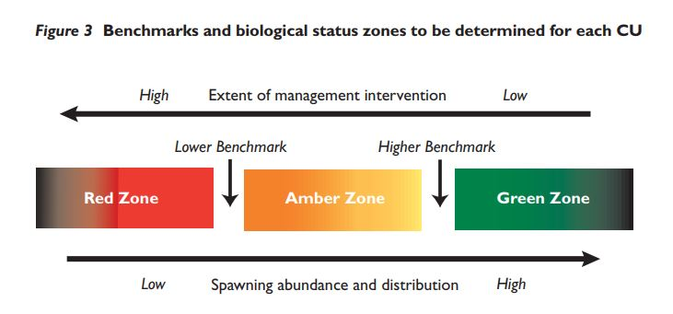
INTRODUCTION
For implementation of the Wild Salmon Policy, the status of salmon Conservation Units (CU) is assessed against ‘biological benchmarks’

Slide 22
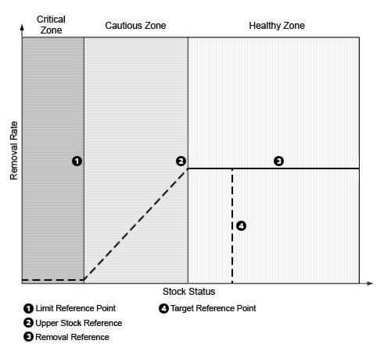
INTRODUCTION
DFO’s general ‘Precautionary Approach’
For harvest management:
Notes:
(PDF) Design of Ecological Risk Criteria for the integrated management of Canadian oceans
Maybe colour + label directly on the figure

Slide 23
INTRODUCTION
Outlook Categories
Outlook Category | CUs or SMUs with references |  | Data-Limited CUs or SMUs
 | Wild Salmon Policy (CU Level) | Precautionary Approach (SMU Level) | Category Definition | Expected spawning abundance
1 | Red Zone (below the LBB) | Critical Zone (below the LRP) | Well below average | <25th percentile
2 | Amber Zone (below the LBB, below the UBB) | Cautious Zone (above the LRP below the USR) | Below Average | 25 to 40th percentile
3 | Green Zone (above the UBB) | Healthy Zone (above the USR) | Near Average | 40 to 60th percentile
4 | Green Zone (at or above the TRP) | Healthy Zone (at or above the TRP) | Abundant | >60th percentile
Data Deficient | - | - | Insufficient information | Unknown

Slide 24
INTRODUCTION
Contributors
The Outlook document reflects the contribution and work of many stock assessment biologists across the region.
Much of the data and information used to create outlooks, status assessments and forecasts, are generated through collaborative programs involving First Nations, and other stakeholders and stewardship groups.
Notes:
Acknowledgments slide??

Slide 25

OUTLOOKS – FRASER AND INTERIOR
Chinook
SMU | Resolution | CU | Outlook
FRASER SPRING RUN 42 CHINOOK SALMON — CHECK: Data entered for the same SMU more than once | CU (singular) | SOUTH THOMPSON-BESSETTE CREEK_SU_1.2 | 1 to 2
FRASER SPRING RUN 42 CHINOOK SALMON — CHECK: Data entered for the same SMU more than once | CU (singular) | SOUTH THOMPSON-BESSETTE CREEK_SU_1.2 | 2 to 3
FRASER SPRING RUN 42 CHINOOK SALMON — CHECK: Data entered for the same SMU more than once | SMU | - | 3
Notes:
FRASER SPRING RUN 42 CHINOOK SALMON — CHECK: Data entered for the same SMU more than once: Test 2 FRASER SPRING RUN 42 CHINOOK SALMON — CHECK: Data entered for the same SMU more than once: Test 3 FRASER SPRING RUN 42 CHINOOK SALMON — CHECK: Data entered for the same SMU more than once: The 2024 field based escapement estimates were below the long-term average, the 2020 parental brood escapement, and the escapement target. Expectations are for continued low abundance in 2025 due to below-average parental escapements in 2021, the November 2021 flooding impacts on eggs (age-4) and parr (age-5), and uncertainty around marine survival and productivity. (2024 Outlook Category 2) FRASER SPRING RUN 42 CHINOOK SALMON — CHECK: Data entered for the same SMU more than once: Test data

Slide 26
OUTLOOKS – FRASER AND INTERIOR
Chum
SMU | Resolution | CU | Outlook
FRASER CHUM SALMON — CHECK: Data entered for the same SMU more than once | CU (singular) | FRASER CANYON | 1 to 2
FRASER CHUM SALMON — CHECK: Data entered for the same SMU more than once | CU (singular) | FRASER CANYON | 4
FRASER CHUM SALMON — CHECK: Data entered for the same SMU more than once | CU (singular) | LOWER FRASER | 2
FRASER CHUM SALMON — CHECK: Data entered for the same SMU more than once | SMU | - | 2
FRASER CHUM SALMON — CHECK: Data entered for the same SMU more than once | SMU | - | 1
Notes:
FRASER CHUM SALMON — CHECK: Data entered for the same SMU more than once: N/A FRASER CHUM SALMON — CHECK: Data entered for the same SMU more than once: Fraser River Chum Salmon spawning escapement has failed to reach the management target in six of the last eight years (2017-2021, 2023). Spawning escapements failed to outperform brood for 2017-2021, while spawning escapements outperformed brood in the most recent three years (2022-2024). The 2024 in-season terminal run estimate was 1,126,000 fish and the 2024 spawning escapement estimate (including age data) will be available by May 2025. Returns in 2025 will be dominated by 4-year-old brood from the 2021 escapement of 533,000 spawners. 2021 saw a historic flooding event during the Chum spawning period that will likely have a negative impact on recruitment. The Lower Fraser Chum CU is assigned an Outlook Category 2 for 2025. (2024 Outlook Category was 2) FRASER CHUM SALMON — CHECK: Data entered for the same SMU more than once: testing entering for entire SMU

Slide 27
OUTLOOKS – FRASER AND INTERIOR
Sockeye River Type
SMU | Resolution | CU | Outlook
FRASER SOCKEYE SALMON - SUMMER | CU (singular) | HARRISON RIVER | 1 to 2
Notes:
FRASER SOCKEYE SALMON - SUMMER: na

Slide 28
OUTLOOKS – NORTH COAST
Chinook
SMU | Resolution | CU | Outlook
CENTRAL COAST CHINOOK SALMON | SMU | - | 1
HAIDA GWAII CHINOOK SALMON | CU (singular) | Outlook assigned but no CU specified | 2
HAIDA GWAII CHINOOK SALMON | CU (singular) | Outlook assigned but no CU specified | 1
Notes:
HAIDA GWAII CHINOOK SALMON: sss CENTRAL COAST CHINOOK SALMON: Bella Coola returns are expected to be below average based on returns in recent years. The 2024 Atnarko River Wild & Enhanced Maximum likelihood model escapement is not yet available but the Peterson escapement estimate was 17, 210. Specific escapement estimates to the Nusatsum, and Saloompt are data deficient. Areas 7 and 8 3 CUs – Dean River Data Deficient . Areas 9 and 10 – Aggregate includes 3 CUs Data Deficient/ Outlook Category 1/ . Owikeno tributary, Wannock River and Docee Chinook returns are unknown. There are multi-species sonar assessments on both the Wannock and Docee Rivers but estimates are data deficient. Recent Chuckwalla/Kilbella returns are well below average based on recent trends.

Slide 29
OUTLOOKS – NORTH COAST
Coho
SMU | Resolution | CU | Outlook
SKEENA COHO SALMON | CU (singular) | LOWER SKEENA | Data Deficient
SKEENA COHO SALMON | CU (singular) | MIDDLE SKEENA | 2
SKEENA COHO SALMON | CU (singular) | SKEENA ESTUARY | Data Deficient
SKEENA COHO SALMON | CU (singular) | UPPER SKEENA | Data Deficient
Notes:
SKEENA COHO SALMON: Middle Skeena Toboggan Creek indicator counts were above average in 2022 and 2023. In 2024, there was a below average return of 2099 coho. 2024 Babine River Counts were also below average in 2024. The Skeena Estuary and Upper Skeena CUs are data deficient. Methods to estimate escapement all Skeena CUs using genetics are currently under review.

Slide 30
OUTLOOKS – NORTH COAST
Sockeye Lake Type
SMU | Resolution | CU | Outlook
HAIDA GWAII SOCKEYE SALMON | SMU | - | 3
SKEENA SOCKEYE SALMON | SMU | - | 4
Notes:
HAIDA GWAII SOCKEYE SALMON: Escapement to Naden have been below average, Copper, Yakoun, and Awun River escapements have been above average. All other CUs are Data Deficient. SKEENA SOCKEYE SALMON: The 2025 preliminary pre-season forecast for the Skeena sockeye aggregate ranges from 1.3 – 5.8 million (80% confidence range), with a point estimate (p50) of 2.7 million.Based on the preseason sibling forecast model, we expect an average return of age-4s, based on an above average return of age-3s (128,500), and a strong return of age-5’s, based on an good return of age-4 sockeye in 2024. The Skeena Sockeye aggregate consists of 90% Pinkut and Fulton spawning channel returns plus all wild stocks. Uncertainty continues with run timing estimates, the in-season forecast, and wild sockeye abundance.

Slide 31
OUTLOOKS – SOUTH COAST
Chinook
SMU | Resolution | CU | Outlook
LOWER GEORGIA STRAIT CHINOOK SALMON | CU (aggregate) | EAST VANCOUVER ISLAND-GOLDSTREAM_FA_0.X, EAST VANCOUVER ISLAND-NANAIMO AND CHEMAINUS_FA_0.X | 1
LOWER GEORGIA STRAIT CHINOOK SALMON | CU (singular) | EAST VANCOUVER ISLAND-COWICHAN AND KOKSILAH_FA_0.X | 3 to 4
MAINLAND INLET CHINOOK SALMON | SMU | - | Data Deficient
MIDDLE GEORGIA STRAIT CHINOOK SALMON | CU (aggregate) | EAST VANCOUVER ISLAND-NANAIMO_SP_1.X, SOUTHERN MAINLAND-GEORGIA STRAIT_FA_0.X, EAST VANCOUVER ISLAND-GEORGIA STRAIT_SU_0.3, EAST VANCOUVER ISLAND-QUALICUM AND PUNTLEDGE_FA_0.X | 1
WCVI CHINOOK SALMON | CU (singular) | Outlook assigned but no CU specified | 1
WCVI CHINOOK SALMON | CU (singular) | WEST VANCOUVER ISLAND-NOOTKA AND KYUQUOT_FA_0.X | 1
WCVI CHINOOK SALMON | CU (singular) | WEST VANCOUVER ISLAND-NORTH_FA_0.X | 1
Notes:
LOWER GEORGIA STRAIT CHINOOK SALMON: he Upper Pitt CU has a higher proportion of five-year-old recruits (~78%) relative to four-year-old recruits'; an aggregate of CUs, e.g., 'For the Rivers aggregate (Wannock River and Owikeno Lake CUs), low returns are expected and the Owikeno Lake productivity based on the Clear Streams Index continues to be below average'; or a particular Area, e.g., 'PFMA Area 3 Chum are expected to be average to above average in 2024 MIDDLE GEORGIA STRAIT CHINOOK SALMON: Testing WCVI CHINOOK SALMON: Escapements of WCVI Chinook natural populations remain low. There has been improvement in Kyuquot (NWVI wild indicators) in recent years. The Clayoquot area (SWVI wild indicators), which remains the biggest concern, saw a drop in 2024 relative to the slight improvement over the previous two years. It is assumed survival rates of natural-origin Chinook are well below those of hatchery-origin Chinook and this discrepancy may be related to the much smaller sizes of natural out-migrating smolts; productivity is therefore anticipated to remain low. WCVI wild Chinook remain a stock of concern. Returns of hatchery Chinook stocks to the WCVI were strong in 2024, consistent with the favourable ocean-entry conditions observed in 2021 and fair in 2022. Conditions in the 2022 and 2023 ocean-entry year appear fair; therefore, expectations are for an average return in 2025. MAINLAND INLET CHINOOK SALMON: Includes Homathko and Klinaklini. DFO is working to expand our programs into the Mainland Inlets. Since 2021, a video counter was installed on Devereux Creek and average annual returns are 850, although additional data review is required. Since 2022, an intensive mark-recapture project has been undertaken on the Southgate River in Bute Inlet and estimated returns have ranged from 832 to 5,175. Although still data deficient, efforts are underway to understand population abundance and trends in these areas.

Slide 32
OUTLOOKS – SOUTH COAST
Chum
SMU | Resolution | CU | Outlook
WCVI CHUM SALMON | SMU | - | 3
Notes:
WCVI CHUM SALMON: Preliminary 2024 returns of WCVI Chum to most systems were improved compared to recent years. Below average brood years 2020, 2021, and 2022 will contribute to the 2025 return as age 5, 4 and 3, respectively. Poor brood performance appears to be buffered by substantial improvements in marine survival for the 2019-2022 ocean entry years. We anticipate that these improvements in productivity will continue for 2025, although the magnitude of improvement in abundance will be limited by the poor brood performance for years contributing to the return. In addition, hatchery production has declined in recent years. 2025 Outlook Category 3

Slide 33
OUTLOOKS – SOUTH COAST
Coho
SMU | Resolution | CU | Outlook
JOHNSTONE STRAIT/MAINLAND INLET COHO SALMON | SMU | - | 2
Notes:
JOHNSTONE STRAIT/MAINLAND INLET COHO SALMON: Area 12 Coho returns have improved substantially against the extremely poor escapement in 2016, but 2024 returns to the Keogh River wild indicator (1753) will fall below the long term average (2,818). Throughout the downturn in abundance, smolt production has remained strong, although smolt abundance in 2024 was 52,546, which was the lowest juvenile outmigration since 2006. It is possible the extensive drought in 2022 negatively impacted spawning success and the number of juveniles produced was lower as a result. Periods of poor marine survival remain a significant risk. The return in 2024 stems from a strong smolt abundance of 92,907, indicating that marine survival was poor. We expect below average returns in 2025 due to the poor outmigration in 2024, combined with stubbornly poor marine survival Area 13 - North Hatchery indicators for this outlook unit are Quinsam and Big Qualicum. Adult returns to the Quinsam were well above average. The wild Coho indicator at Black Creek also saw well above average adult (9,500) and higher jack (4,500) returns than average. General observations to date suggest the 2024 forecast under-estimated returns. Unfortunately, after several years of above average smolt production, we saw the lowest smolt outmigration (~39,000) since 2017. Expectations for 2025 are for below average to average escapement, following low smolt abundance in 2024.

Slide 34
OUTLOOKS – SOUTH COAST
Pink Even
SMU | Resolution | CU | Outlook
ECVI/MAINLAND PINK SALMON - EVEN — CHECK: Data entered for the same SMU more than once | CU (singular) | GEORGIA STRAIT | 1 to 2
ECVI/MAINLAND PINK SALMON - EVEN — CHECK: Data entered for the same SMU more than once | CU (singular) | GEORGIA STRAIT | 3
ECVI/MAINLAND PINK SALMON - EVEN — CHECK: Data entered for the same SMU more than once | CU (singular) | SOUTHERN FJORDS | 2 to 3
Notes:
ECVI/MAINLAND PINK SALMON - EVEN — CHECK: Data entered for the same SMU more than once: never, but I would love to ECVI/MAINLAND PINK SALMON - EVEN — CHECK: Data entered for the same SMU more than once: Even Year: 2024 saw improved returns throughout the South Coast with returns approaching or exceeding the long-term average for systems on Vancouver Island and in the Mainland Inlets. Returns were somewhat below the long-term average for the mainland, but most systems exceeded the recent (3 cycle) generational average. Expectations for 2026 are for a stabilization of abundance for Pink Salmon returning to ECVI and the mainland. Pink returns are highly variable, and confidence in the forecasted return in 2026 is low, but average returns to this region are expected in 2026 Odd Year: 2023 saw varied returns throughout South Coast, but generally abundance increased over the brood year. Returns to Northern Vancouver Island were below the historical adult abundance, although with clear signs of improvement since escapement hit its lowest point in 2016/2017. The mainland inlets in Area 12 saw continued poor escapement of Pink Salmon, but again with improvements over the brood year. Expectations north of Adam River are for continued improvements in 2025, with potential to approach the long-term average escapement. Particularly strong returns were observed in 2023 to major systems including Adam, Quinsam, Tsolum and Jervis Inlet while unenhanced returns to Big Qualicum continue to grow. Above average escapements to these systems and promising fry counts from the Quinsam River suggest that we will see average to above average escapements for systems south of Adam River in 2025.

Slide 35
OUTLOOKS – SOUTH COAST
Sockeye Lake Type
SMU | Resolution | CU | Outlook
WCVI - BARKLEY SOCKEYE SALMON | CU (singular) | GREAT CENTRAL | 3
WCVI - BARKLEY SOCKEYE SALMON | CU (singular) | HENDERSON | 2
WCVI - BARKLEY SOCKEYE SALMON | CU (singular) | SPROAT | 3
Notes:
WCVI - BARKLEY SOCKEYE SALMON: Sproat Lake CU: The two main contributing brood years to the 2025 run are 2020 and 2021 and the two main contributing smolt years are 2022 and 2023. Brood abundances were below average in 2020 and 2021 particularly in Great Central Lake, but improved relative to 2019. Smolt abundances were low in both Great Central Lake and Sproat Lake in 2022 and 2023. Based on ocean indicators and returns to date, marine survival rates for the 2022 and 2023 smolt years are - good. Given the considerations above, expectations are for an average Somass Sockeye return in 2025. Henderson Lake CU: For the 2025 return, the two main contributing brood years are 2020 and 2021 and the two main contributing smolt years are 2022 and 2023. Brood abundance was low in 2020 but improved in 2021. Based on ocean indicators, marine survival rates for the 2022 and 2023 smolt years are likely average in 2023. The 2024 Henderson adult return, however, was low and the age composition data showed similar abundances of 42s and 52s. this may bias the outlook downward to a below-average return.

Slide 36
OUTLOOKS – YUKON TRANSBOUNDARY
Chinook
SMU | Resolution | CU | Outlook
PORCUPINE CHINOOK SALMON | SMU | - | 1
STIKINE CHINOOK SALMON | SMU | - | 1
YUKON CHINOOK SALMON | SMU | - | 1
Notes:
PORCUPINE CHINOOK SALMON: The spawning escapement of Canadian-origin Yukon River mainstem Chinook salmon in 2024 was well below average at 24,183. The recent rebuilding target of 71,000 Mainstem Chinook endorsed by the Alaska Department of Fish and Game and Fisheries and Oceans under the newly signed Agreement of April 1, 2024 regarding Canadian-origin Yukon River Chinook Salmon for 2024 through 2030 was not met. In five and six year old fish dominate returns. Recent total production observed in Canadian-origin Yukon River Chinook salmon stocks is well below past years, averaging around 66,000 over the last ten years, compared to 150,000 in the 1980s and 1990s. Recent (2020 to 2023) forecast accuracy of escapement into Canada has been poor, likely due to on route mortality. 2024 escapement fell within pre-season range of 19,000 to 28,000). Assessment of Porcupine Chinook continues however with limited data. Outlook Category 1 YUKON CHINOOK SALMON: Aggregate includes 9 CUs . 71,000 Rebuilding Target (SMSR) STIKINE CHINOOK SALMON: The 2025 run is forecast to be well below the 10-year average of 14,475 and below the escapement goal range of 14,000 – 28,000. The

Slide 37
OUTLOOKS – YUKON TRANSBOUNDARY
Chum
SMU | Resolution | CU | Outlook
PORCUPINE CHUM SALMON | CU (singular) | Outlook assigned but no CU specified | 1
Notes:
PORCUPINE CHUM SALMON: testing if paragraphs show up does this work??

Slide 38
OUTLOOKS – YUKON TRANSBOUNDARY
Coho
SMU | Resolution | CU | Outlook
PORCUPINE COHO SALMON | CU (singular) | PORCUPINE | Data Deficient
STIKINE COHO SALMON | CU (singular) | LOWER STIKINE | 3
TAKU COHO SALMON | SMU | - | 3
Notes:
STIKINE COHO SALMON: hi chelsea! happy thursdayyyyyyy PORCUPINE COHO SALMON: Very little is known about Coho Salmon stock status within Canadian portions of the Yukon River drainage. Data from the U.S. portion of the drainage suggest runs to the drainage have been below average in three of the past five years, with a declining trend. No assessment programs are currently undertaken in Canada and the current stock status is unknown. It is known that coho salmon primarily return as 4-year-olds and overlap with the tail end of the fall chum run. TAKU COHO SALMON: Based on preliminary smolt abundance in 2024 combined with recent smolt-to-adult survival rates, an average run above the management target of 70,000 is expected for 2025. Run is an even split of 3 and 4 year olds.

Slide 39
OUTLOOKS – YUKON TRANSBOUNDARY
Sockeye Lake Type
SMU | Resolution | CU | Outlook
ALSEK SOCKEYE SALMON | SMU | - | 3
STIKINE SOCKEYE SALMON | CU (singular) | CHRISTINA | 2
STIKINE SOCKEYE SALMON | CU (singular) | CHUTINE | 2
STIKINE SOCKEYE SALMON | CU (singular) | TAHLTAN | 3
Notes:
ALSEK SOCKEYE SALMON: Based on brood year escapements that were both above and below the MSY target range and stock-recruitment relations from historical records, a below average, but within the escapement goal range run is expected. This aggregate stock is dominated by lake and river type age 5 fish. STIKINE SOCKEYE SALMON: Based on a combination of primary brood year smolt counts and sibling-based predictions, an average run is anticipated for 2025 and it is expected escapement objectives will be achieved. This is an aggregate stock of lake and river type 5 year olds.

